Slide 1
BASIC PYTHON DATAMANIPULATION

Slide 2
BASIC PYTHON DATAMANIPULATION OBJECTIVES
Base Python Manipulation project is focused on mastering fundamental data manipulation techniques using base python. By diving deep into these foundational aspects of python, you will build a solid understanding that forms the basis for more advanced programming concepts and applications.
Working with python data structures list, tuple, set and dictionary to store and manipulate data.
Using List comprehension, Set comprehension and Dictionary comprehension in python that allow for concise and efficient way to create lists, sets and dictionaries.

Slide 3
Using Conditional statements like if, elif, else and nested if for perform different actions based on whether a certain condition evaluates to true or false.
Using Loop for performing the same or different operations on multiple elements at the same time.
To show the control flow statement in python for controlling the flow of execution in a program.
Using Function to organize code by breaking it into smaller, logical units, making it easier to understand and maintain.

Slide 4
Conditional Statement : if statement, else statement, elif-statement, Nested-if
Conditional statement in python are used to perform different actions based on whether a certain condition evaluates to true or false.
if statement: Executes a block of code only if a specified condition is true.
else statement: It checks a condition and executes one block of code if the condition is true, and another block if it's false.
elif-statement: It checks multiple condition in sequence and executes the block of code associated with the first true condition. If none of the conditions are true, the else block is executed.
Nested-if: Nested if statement in python allow you to have an if statement inside another if statement.

Slide 5
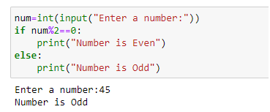
Question No(1) write a program that takes an integer as input and prints whether it is an odd or even number?
Code:
Result:

Slide 6
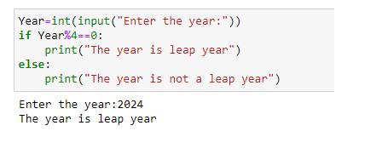
Question No(2) write a program that check whether a given year is leap year?
Code:

Slide 7
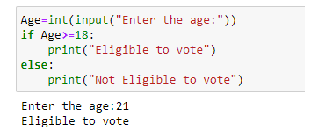
Question No(3) write a program to check whether a person is eligible to vote?
Code:

Slide 8
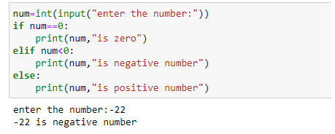
Question No(4) write a program determining whether a given number is positive, negative or zero?
Code:

Slide 9
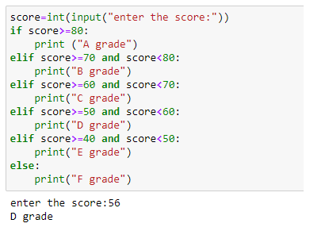
Question No(5) write a program that take a student's score as input and print their grade(A,B,C,D,E,F )based on the score?
Code:

Slide 10
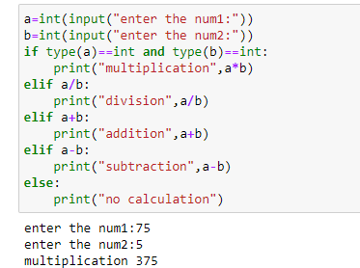
Question No(6) create a simple calculator program with a menu that allows users to perform addition,subtraction,multiplication,division based on their choice?
Code:

Slide 11
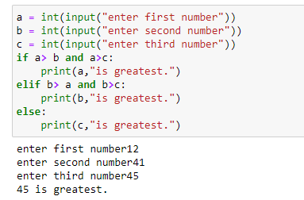
Question No(7) write a program that find and print the greatest number among three input numbers?
Code:

Slide 12
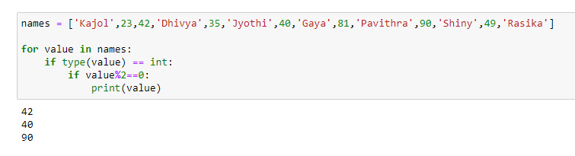
Question No(8) names = ['Kajol',23,42,'Dhivya',35,'Jyothi',40,'Gaya',81,'Pavithra',90,'Shiny',49,'Rasika'] Print only the even numbers present in the given list?
Code:

Slide 13
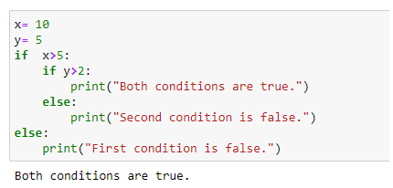
Question No(9) write a program that find and print x=10 and y=5 these values agree the condition that x>5 and y>2?
Code:

Slide 14
String Indexing
String indexing in python allows you to access individual characters in a string using their position. Indexing in python starts at 0. We can also use negative indexing, where -1 refers to the last character.

Slide 15
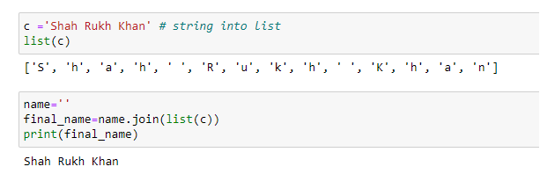
Question No(10) c ='Shah Rukh Khan' convert the string into list and convert back to orginal string?
Code:

Slide 16
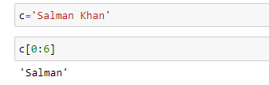
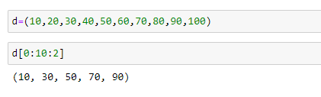
Question No(11) c='Salman Khan' display only 'Salman'?
Code:
Question No(12) d=(10,20,30,40,50,60,70,80,90,100) display only even index values?
Code:

Slide 17
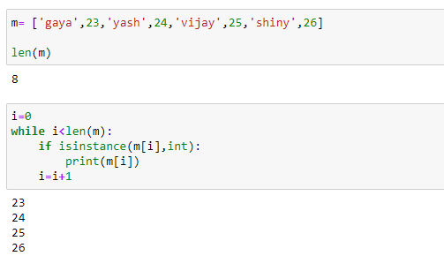
Question No(13) m= ['gaya',23,'yash',24,'vijay',25,'shiny',26] get only the integers?
Code:

Slide 18
Loop : While loop , For loop , Nested loop
While loop: While loop is entry controlled loop. Four components of while loop are: (1) Initialization: to initialize a value. (2) Entry condition: to enter a while loop, the entry condition should be satisfied. (3) stopping condition: to stop the loop. (4) Increment or Decrement criteria: to move forward or backward the loop.
For loop: For loop in python is used to iterate over a sequence such as list, tuple, dictionary, set.it allows you to execute a block of code multiple times.
Nested loop: Nested loop in python is a loop inside another loop. This means that one loop is placed inside the body of another loop.

Slide 19
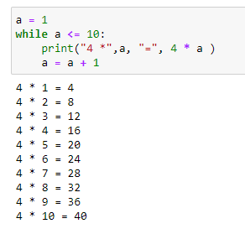
While loop Question No(14) Print the table of 4 using while loop?
Code:

Slide 20
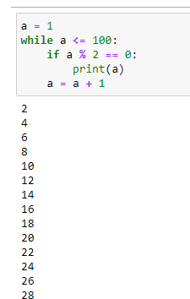
Question No(15) print the even numbers till 100 using while numbers?
Code:

Slide 21
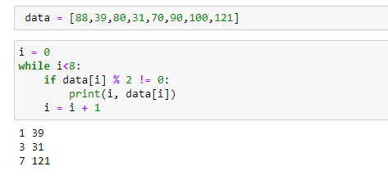
Question No(16) data = [88,39,80,31,70,90,100,121] Print only the odd values and their indexes from the given list using the while loop?
Code:

Slide 22
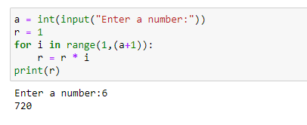
For loop: Question No(17) Factorial of any number using the for loop?
Code:

Slide 23
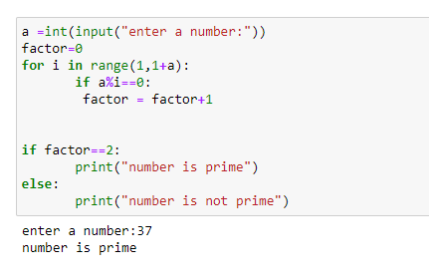
Question No(18) Take a input value from the users to check whether it is prime or not?
Code:

Slide 24
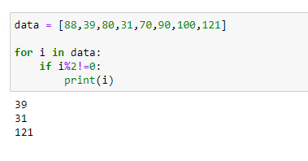
Question No(19) data = [88,39,80,31,70,90,100,121] Print only the odd numbers from the given list using the for loop?
Code:

Slide 25
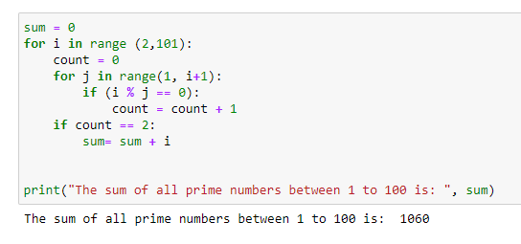
Nested loop Question No(20) Get the sum of all the prime numbers between 1 to 100?
Code:

Slide 26
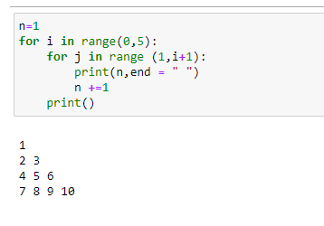
Question No(21) Make a floyd's triangle?
Code:

Slide 27
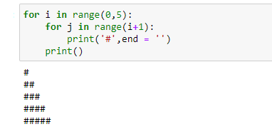
Question No(22) Construct a Right angle triangle pattern for '#'?
Code:

Slide 28
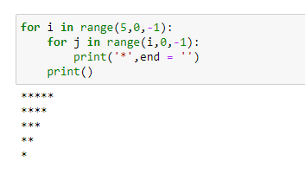
Question No(23) Construct a Inverted right angled triangle?
Code:

Slide 29
Control Flow Statement : Break, Continue, Pass
Break: Break is the terminator. it terminates the loop as soon as it gets executed.
Continue: it skips the present position and moves to the next position. Continue does not terminate the loop.
Pass: it is just pass the loop.

Slide 30
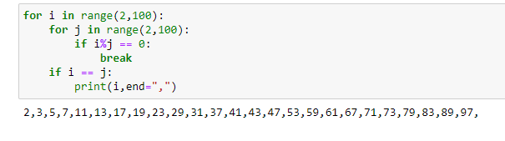
Break Question No(24) Write a program to get the prime numbers between 1 to 100?
Code:

Slide 31
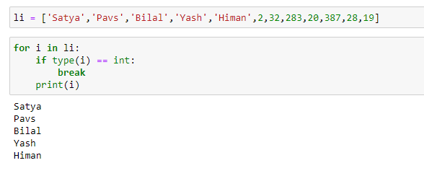
Question No(25) li = ['Satya','Pavs','Bilal','Yash','Himan',2,32,283,20,387,28,19] Get only the names from the list using break statement in the loop?
Code:

Slide 32
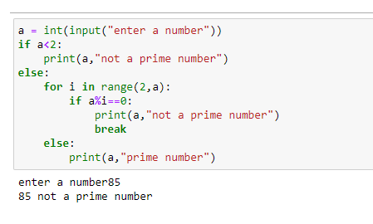
Question No(26) Take a input number from the user and check whether it is prime or not?
Code:

Slide 33
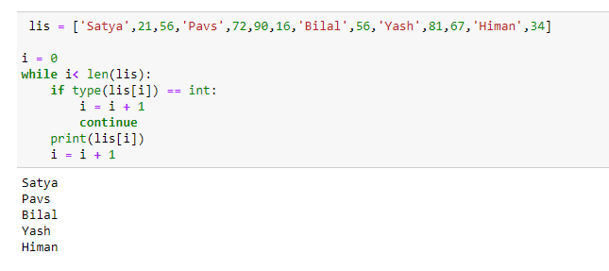
Continue Question No(27) lis = ['Satya',21,56,'Pavs',72,90,16,'Bilal',56,'Yash',81,67,'Himan',34] Get only the names from given list?
Code:

Slide 34
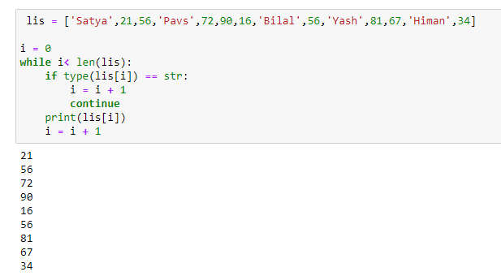
Question No(28) ['Satya',21,56,'Pavs',72,90,16,'Bilal',56,'Yash',81,67,'Himan',34] Get only the numbers from given list?
Code:

Slide 35
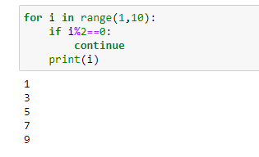
Question No(29) Print only the odd numbers between 1 to 10 using continue statement?
Code:

Slide 36
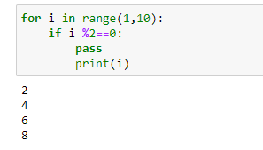
Pass Question No(30) Using pass statement print only the even numbers between 1 to 11?
Code:

Slide 37
List Comprehensions
Only one line of code for looping.
It uses 'For Loop’.
It always gives a list as an output.
syntax: output= [(output_value) for alias_name in list if priority_condition()]

Slide 38
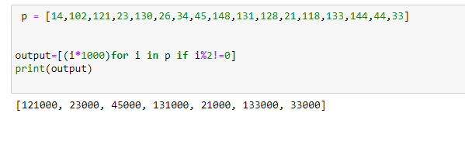
Question No(31) p = [14,102,121,23,130,26,34,45,148,131,128,21,118,133,144,44,33] From the given list , get only odd numbers and add them into a new list after multiplying them with 1000?
Code:

Slide 39
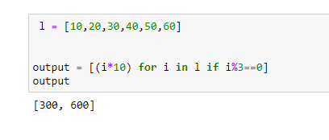
Question No(32) l = [10,20,30,40,50,60] add the data which is divisible by 3 in a new list after multiplying each number by 10?
Code:

Slide 40
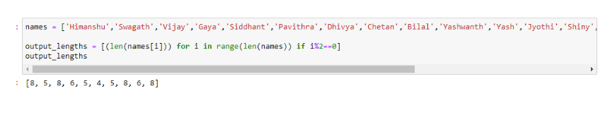
Question No(33) ['Himanshu','Swagath','Vijay','Gaya','Siddhant','Pavithra','Dhivya','Chetan','Bilal','Yashwanth','Yash','Jyothi','Shiny','Kajol','Jaspreet','Shankar','Rasika','Akash','Satyajit'] =names, enter the lengths of each name which is present at even indexes in a new list?
Code:

Slide 41
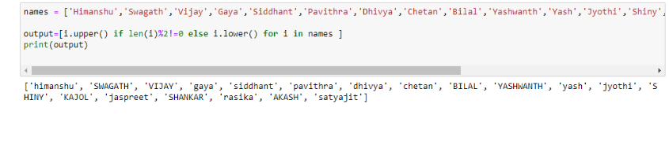
Question No(34) ['Himanshu','Swagath','Vijay','Gaya','Siddhant','Pavithra','Dhivya','Chetan','Bilal','Yashwanth','Yash','Jyothi','Shiny','Kajol','Jaspreet','Shankar','Rasika','Akash','Satyajit'] = names From the given list if the length of the name is odd, then store the name in Upper case and if the length of the name is even, then store the name in Lower case?
Code:

Slide 42
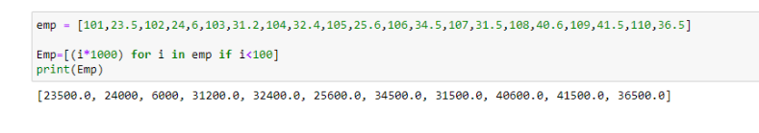
Question No(35) [101,23.5,102,24.6,103,31.2,104,32.4,105,25.6,106,34.5,107,31.5,108,40.6,109,41.5,110,36.5] = emp In the list, ten employees ids and their salaries are given. You have to store their salaries in a new list after multiplying each value with 1000?
Code:

Slide 43
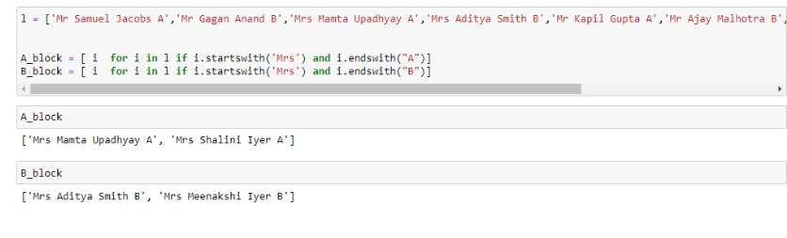
Question No(36) l = From the list, store the names of only females from both the blocks and store them in two new lists A_block and B_block?
Code:

Slide 44
Set Comprehension
It always gives a set as an output.
Only one line of code for looping.
syntax: {expression for element in iterable(if condition)

Slide 45
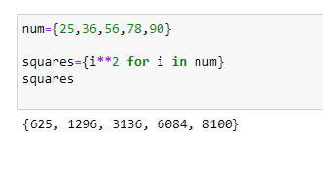
Question No(37) num={25,36,56,78,90} create a new set containing the squares of the numbers?
Code:

Slide 46
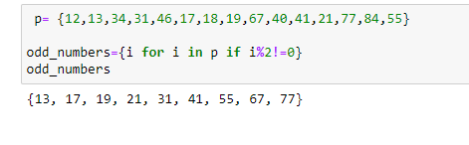
Question No(38) p= {12,13,34,31,46,17,18,19,67,40,41,21,77,84,55} create a new set containing the odd numbers?
Code:

Slide 47
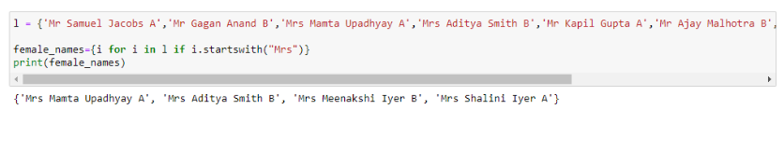
Question No(39) l = {'Mr Samuel Jacobs A','Mr Gagan Anand B','Mrs Mamta Upadhyay A','Mrs Aditya Smith B','Mr Kapil Gupta A','Mr Ajay Malhotra B','Mrs Shalini Iyer A','Mrs Meenakshi Iyer B'} create a new set containing only female names?
Code:

Slide 48
Dictionary Comprehension
It always gives a dictionary as an output.
Only one line of code for looping.
syntax: {key_expression:value_expression for element in iterable}

Slide 49
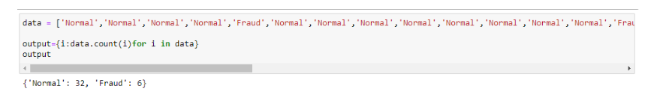
Question No(40) ['Normal','Normal','Normal','Normal','Fraud','Normal','Normal','Normal','Normal','Normal','Normal','Normal','Normal','Fraud','Normal','Normal','Fraud','Normal','Normal','Normal','Normal','Normal','Normal','Fraud','Normal','Normal','Normal','Normal','Normal','Normal','Normal','Normal','Fraud','Normal','Normal','Fraud','Normal','Normal'] = data Find the count of fraud?
Code:

Slide 50
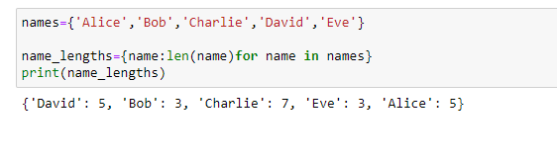
Question No(41) names={'Alice','Bob','Charlie','David','Eve'} create a dictionary with name and length of the names?
Code:

Slide 51
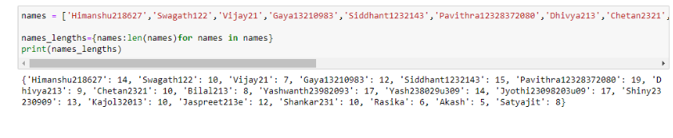
Question No(42) ['Himanshu218627','Swagath122','Vijay21','Gaya13210983','Siddhant1232143','Pavithra12328372080','Dhivya213','Chetan2321','Bilal213','Yashwanth23982093','Yash238029u309','Jyothi23098203u09','Shiny23230909','Kajol32013','Jaspreet213e','Shankar231','Rasika','Akash','Satyajit'] = names create a new dictionary with names and length of names?
Code:

Slide 52
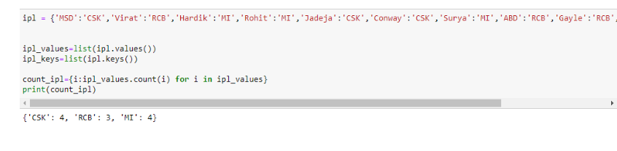
Question No(43) {'MSD':'CSK','Virat':'RCB','Hardik':'MI','Rohit':'MI','Jadeja':'CSK','Conway':'CSK','Surya':'MI','ABD':'RCB','Gayle':'RCB','Bumrah':'MI','Raina':'CSK'}=ipl create a new dictionary with output like {'CSK' :4,'RCB' :3,'MI' :4}?
Code:

Slide 53
User-Defined Function
In python ,user defined functions allows you to create reusable block of code to perform specific tasks.
They are defined using the def keyword followed by the function name and parentheses containing any parameters.

Slide 54
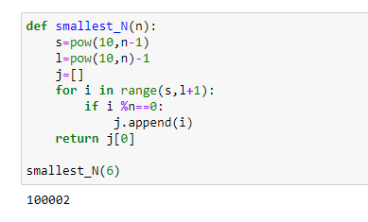
Question No(44) Create a UDF to find the smallest 'n' digit number divisible by 'n'?
Code:

Slide 55
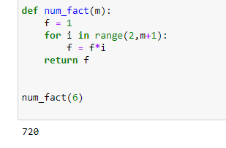
Question No(45) Create a UDF which gives the factorial of any number?
Code:

Slide 56
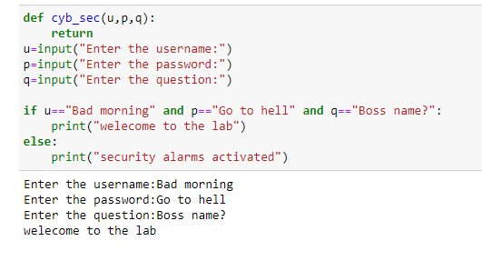
Question No(46) create a UDF which take a username as an input and password as an input and your favorite question as an input.if the password ,username and question matches: print("Welecome to the lab") else print("Security Alarms Activated")?
Code:

Slide 57
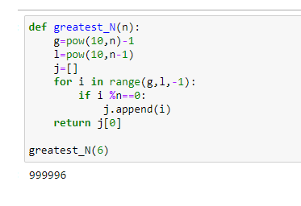
Question No(47) Create a UDF to find the greatest 'n' digit number divisible by 'n'?
Code:

Slide 58
Lambda Function
Lambda functions are anonymous functions.
It contains a single line code and they don't have any name like UDFs.
There are 3 functions are used with lambda function: map(), filter(), reduce().
For mathematical operation map() is used with lambda function and for filtering the data filter()is used with lambda function.

Slide 59
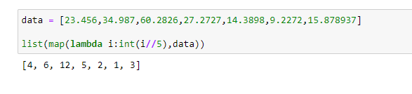
Question No(48) [23.456,34.987,60.2826,27.2727,14.3898,9.2272,15.878937] = data , Using the lambda function, you have to get the floor value of each of the value given in the original list?
Code:

Slide 60
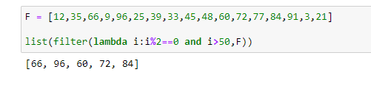
Question No(49) F = [12,35,66,9,96,25,39,33,45,48,60,72,77,84,91,3,21] Get those even values which are greater than 50 from the list using lambda function?
Code:

Slide 61
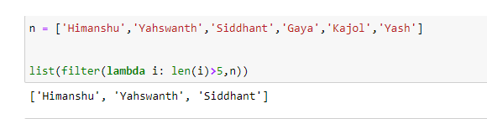
Question No(50) n =['Himanshu’, 'Yahswanth’, 'Siddhant’, 'Gaya’, 'Kajol’, 'Yash'] Display only the name whose length is greater than 5 using lambda function?
Code:

Slide 62
Inheritance
Inheritance is a property in Object-Oriented programming (oop). In which derived class or child class inherits some properties of parent class. The child class able to access the methods and instance variables of a parent class then we don't want to create the object of a parent class.
Types of Inheritance:
Single Inheritance: A child class inherits only from base class. Here we have only one parent child relationship.
Multiple Inheritance: A single child class can inherits the properties of more than one parent class. Here a single child and multiple parents relationship.

Slide 63
Multilevel Inheritance: A class inherits properties and behaviors from another class, which in turn may inherit from another class. It is a step wise inheritance.
Hierarchial Inheritance: ability of a subclass to inherit properties and behavior from multiple superclasses, forming a hierarchical tree-like structure. This allows for the creation of increasingly specialized classes, each building upon the characteristics of its parent classes. Here one parent and two child relationship.
Hybrid Inheritance: It is the combination of single, multiple, multilevel and hierarchial inheritance.

Slide 64

Question No(51) Create a single inheritance?
Code:

Slide 65

Question No(52) Create a single inheritance of class car?
Code:

Slide 66

Question No(53) Create a inheritance to show one parent - child relationship?
Code:

Slide 67

Question No(54) Single Inheritance to show Manager and Employee relation ?
Code:

Slide 68

Question No(55) Create a Multiple Inheritance?
Code:

Slide 69

Question No(56) Create a inheritance to show multiple parent with one child relationship?
Code:

Slide 70

Question No(57) Multiple Inheritance to show the relation of Work from home, Work from Office and Hybrid?
Code:

Slide 71

Question No(58) Create a multilevel inheritance?
Code:

Slide 72

Question No(59) Multilevel Inheritance to show the iPhone 13, iPhone 14 and iPhone 15 relations?
Code:

Slide 73

Question No(60) Create Hierarchial Inheritance in a company's organisational structure?
Code:

Slide 74

Question No(61) Create a Hybrid Inheritance?
Code:

Slide 75
Polymorphism
Polymorphism is a property by which one method can perform multiple operation with same time..

Slide 76

Question No(62) Create a program to show polymorphism?
Code:

Slide 77
CONCLUSION
Base Python Manipulation Objectives are focused on mastering fundamental data manipulation techniques using base python. Working with python data structures list, tuple, set and dictionary to store and manipulate data. Implementing user-defined functions to encapsulate reusable blocks of code. Using control flow statements and loops to create interactive functionality. Enhancing the user experience by providing clear prompts and instructions. Over all this project covers basic functionality and provided a solid foundation in python programming.

